Slide 1
Comparative analysis of Data Compression using Dimensionality Reduction techniques
Presented by: Himalaya Sharma
Last updated: 24th July, 2022

Slide 2



Team members
GROUP 40
Priyanka Uttarwar
Himalaya Sharma
Swapnil Baluja

Slide 3
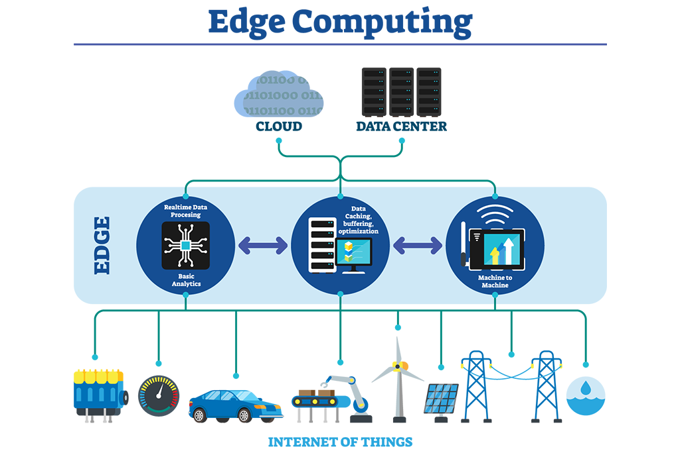
Motivation
Data flows from sensors -> edge -> cloud.
Enormous influx of sensor data makes data footprint high.
Data compression becomes essential.
Sensor nodes are resource constrained.
Base stations/edge devices are more capable.
Fig. 1. Edge computing: “Real-Life Use Cases for Edge Computing”, https://innovationatwork.ieee.org/real-life-edge-computing-use-cases/

Slide 4
Literature
<Write something about past work done on data compression using dimensionality reduction>

Slide 5
Literature
<Write something about past work done on data compression using dimensionality reduction>

Slide 6
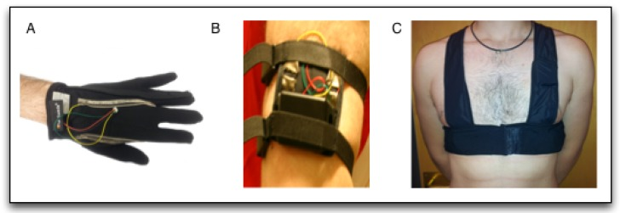
Problem Statement
We have physiological sensor data, namely, ECG, TEB and EDA.
Want to store this data in cloud.
Problems:
Sensor data is large in size (20.9 MiB), and
high-dimensional (533 features)
Data compression using dimensionality reduction techniques can be employed to solve these problems.
Fig. 2. (A) Glove to acquire EDA signal in hand; (B) Arm bracelet to acquire EDA signal; (C) Vest to acquire ECG and TEB signals: “Activity Recognition Using Wearable Physiological Measurements: Selection of Features from a Comprehensive Literature Study”, https://www.ncbi.nlm.nih.gov/pmc/articles/PMC6960825/

Slide 7
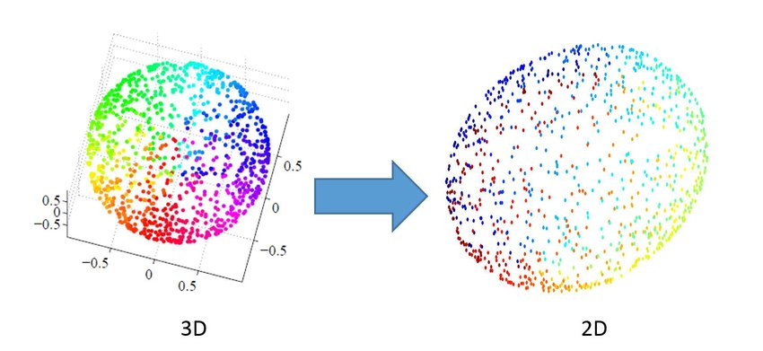
Methodology
Experimented with the following dimensionality reduction algorithms on this data:
FEATURE EXTRACTION
Linear methods
Principal Component Analysis (PCA)
Linear Discriminant Analysis (LDA)
Truncated SVD
Non-linear methods
t-SNE
MDS
Isomap
Fig. 3. Dimensionality reduction effect over an artificial (3-dimensional) spherical shell manifold: “Interactive Data Visualization Using Dimensionality Reduction and Similarity-Based Representations”, https://www.researchgate.net/publication/313787026_Interactive_Data_Visualization_Using_Dimensionality_Reduction_and_Similarity-Based_Representations

Slide 8
Methodology
Experimented with the following dimensionality reduction algorithms on this data:
FEATURE SELECTION
Backward elimination
Forward selection
Random forest

Slide 9
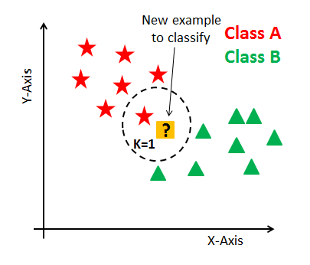
Methodology
How do we decide how many features/dimensions to retain?
Data use-case is activity recognition.
There are 4 possible activities - neutral, emotional, mental & physical.
Compress data keeping this target variable in mind.
Used a K-Nearest Neighbors with n_neighbours=5 as baseline classifier.
Employed a multi-class classification accuracy threshold of 0.8 to decide the number of features/dimensions to retain.
Fig. 4. K-Nearest Neighbors: “K-Nearest Neighbors”, https://www.datacamp.com/tutorial/k-nearest-neighbor-classification-scikit-learn

Slide 10
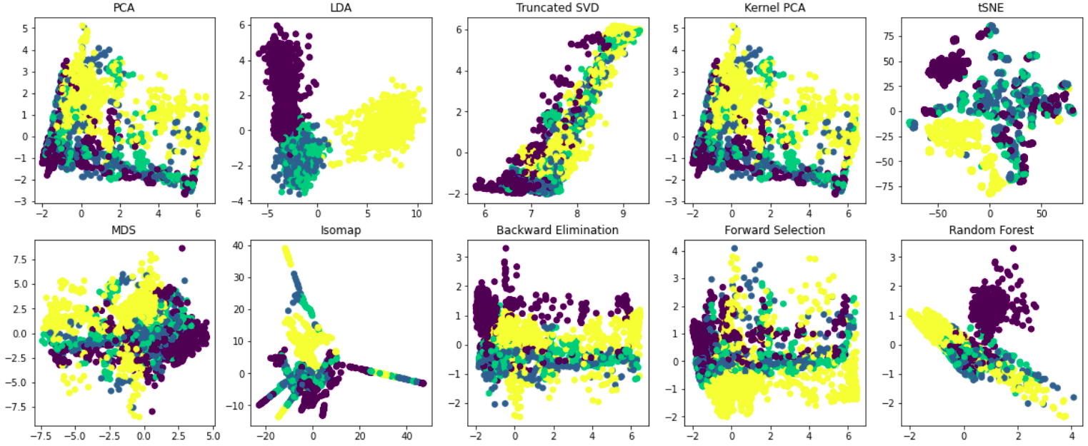
Experimental Results

Slide 11
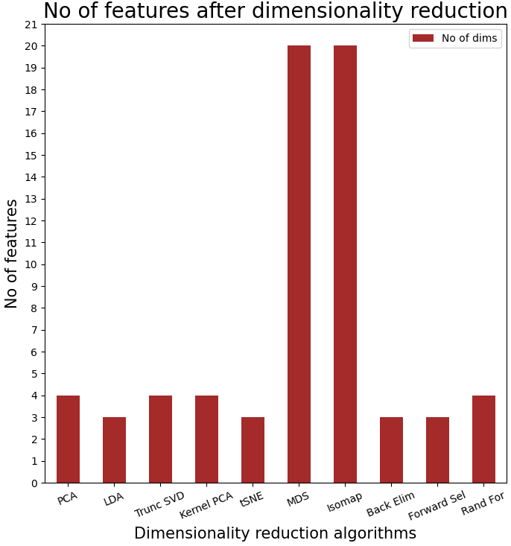
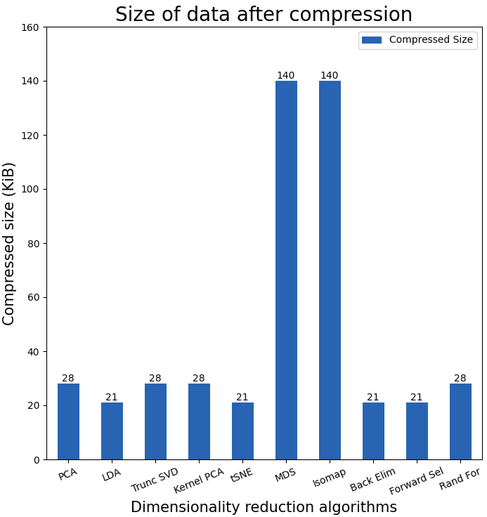
Experimental Results

Slide 12
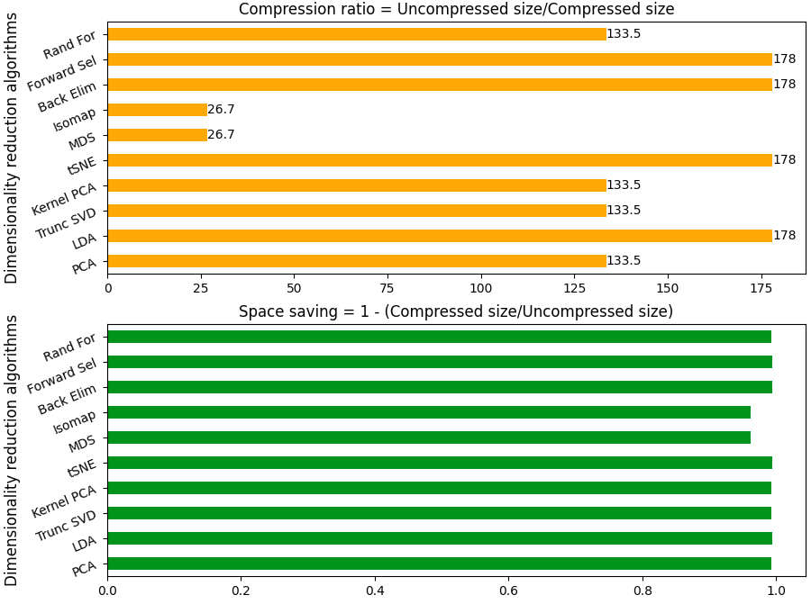
Experimental Results

Slide 13
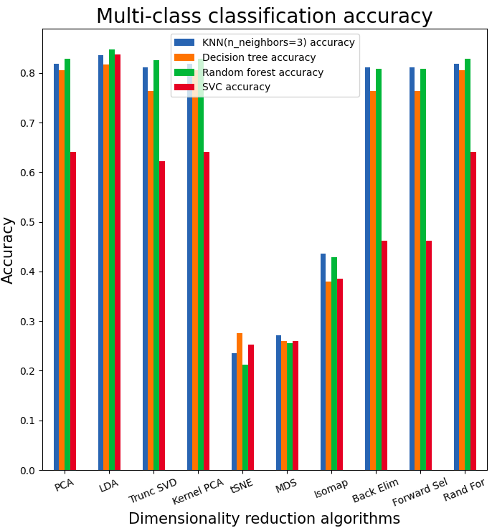
Experimental Results
Tested the following classical classification ML algorithms on reduced data:
K-Nearest neighbors (n_neighbors=3)
Decision tree
Random Forest
Support Vector Classifier

Slide 14
Conclusion
LDA, PCA and Random forest (for feature selection) are the top 3 dimensionality reduction techniques for our use-case.
Trade-off between classification performance and reduction in dimensions is high for non-linear feature extraction dimensionality reduction techniques.
Trade-off between classification performance and reduction in dimensions is low for linear feature extraction & feature selection dimensionality reduction techniques.

Slide 15
References
Mohino-Herranz I, Gil-Pita R, Rosa-Zurera M, Seoane F. Activity Recognition Using Wearable Physiological Measurements: Selection of Features from a Comprehensive Literature Study. Sensors (Basel). 2019 Dec 13;19(24):0. doi: 10.3390/s19245524. PMID: 31847261; PMCID: PMC6960825.
Compression ratio. (2022, June 2). In Wikipedia. https://en.wikipedia.org/wiki/Compression_ratio

Slide 16

Thanks!

